Slide 1
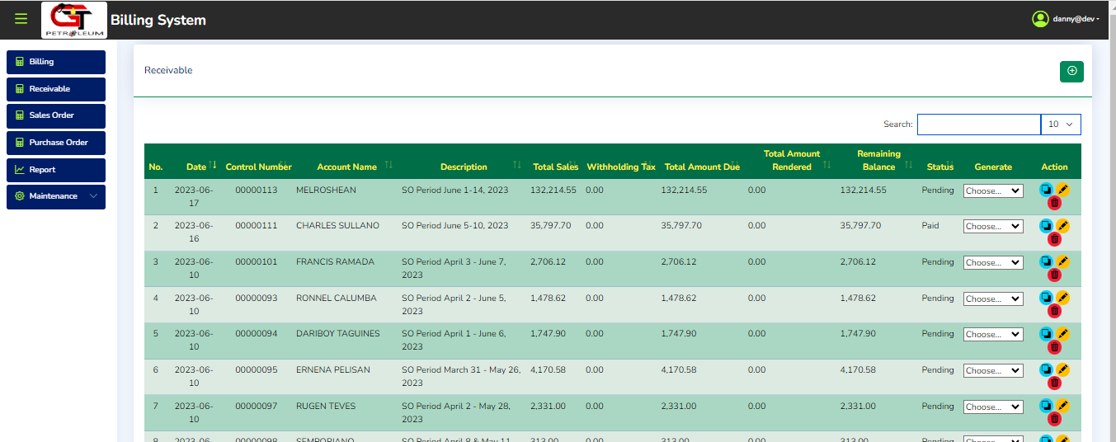
1.) To Create new receivable, Go to Receivable page
2.) Click the Add Button to proceed to Create Receivable Page

Slide 2
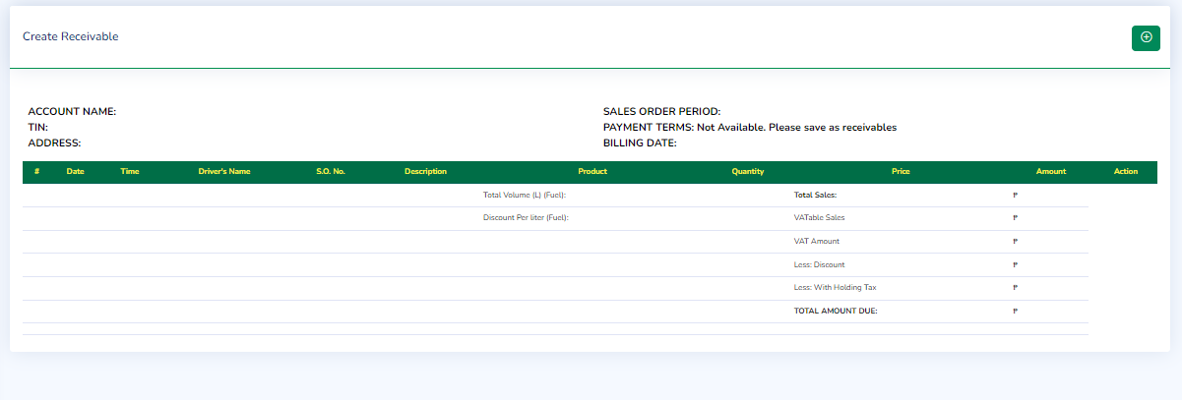
3.) Fill the Options

Slide 3
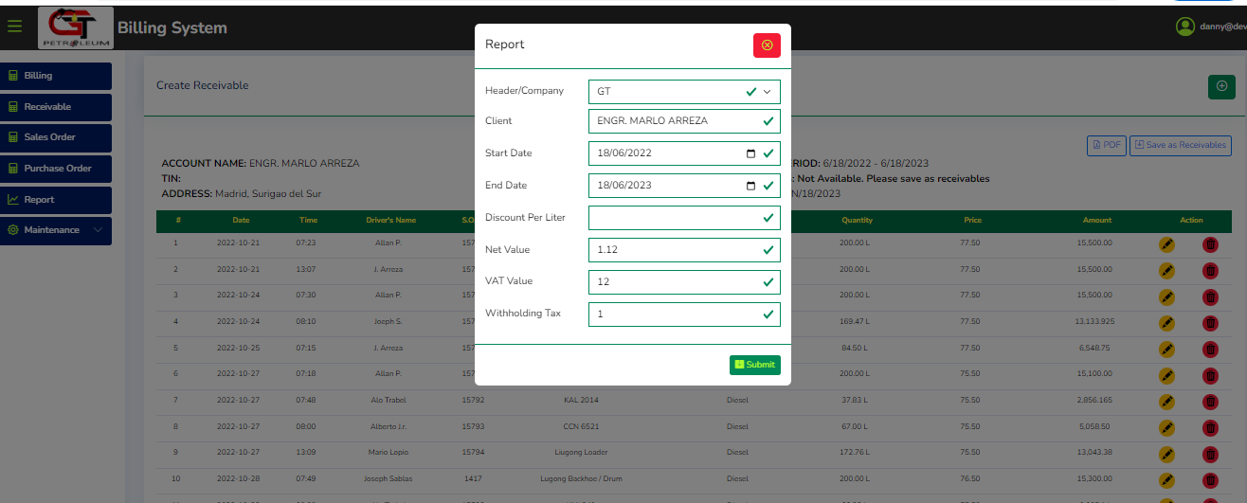
4.) Submit to Generate

Slide 4
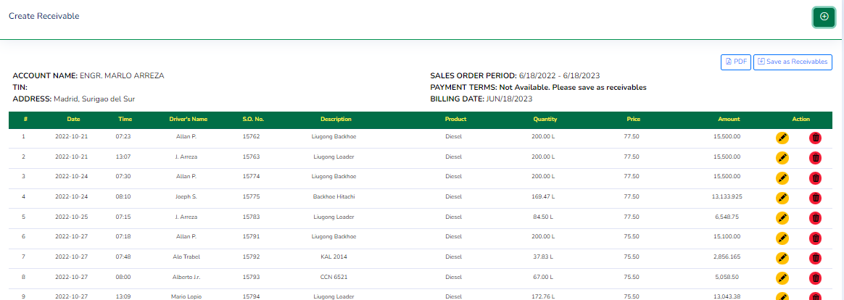
5.) Click to open form and fill up the options to Save as receivable
6.) After Saving as receivable Actions(delete/edit) will be disabled

